Slide 1
New Paying Slip Introducing Program
Provincial Auditorium
North Central Province

Slide 2
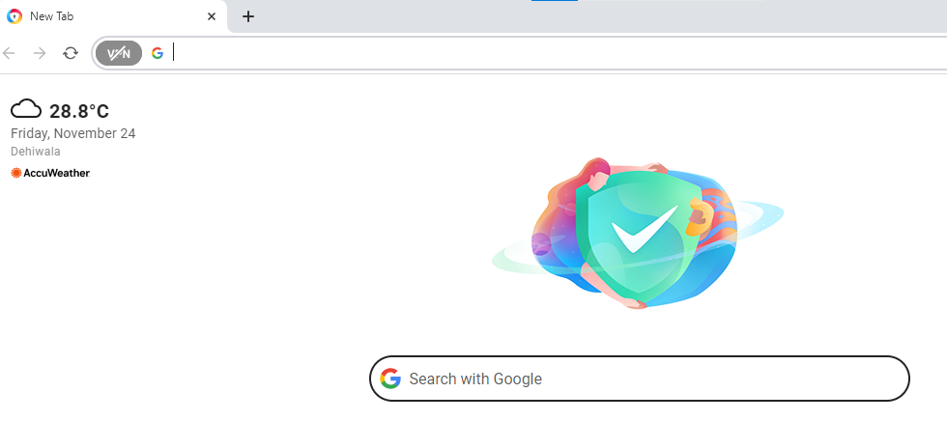
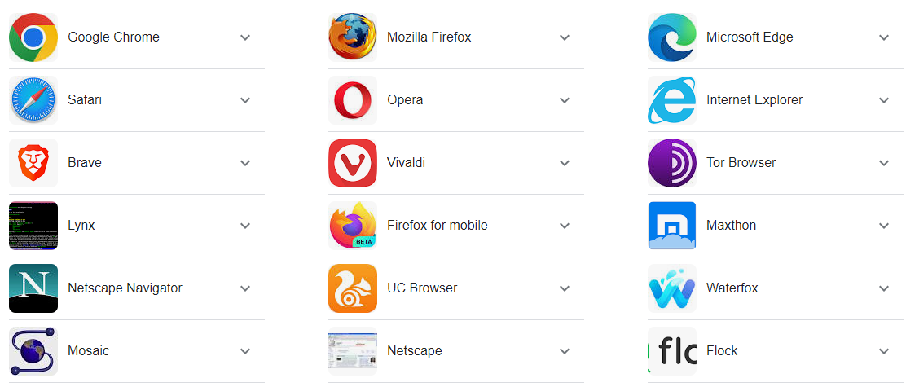
Open any web browser your PC

Slide 3

Then type following URL in address bar.

Slide 4
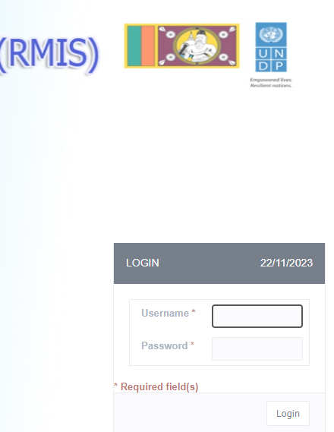
Now

Slide 5
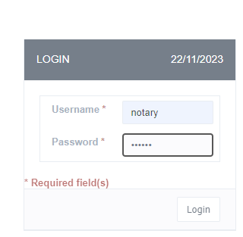
Then
Enter Your user name & Password

Slide 6
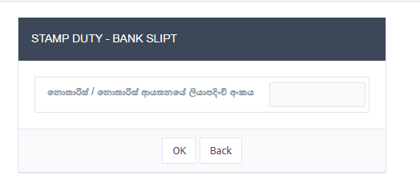
Now Enter your Registration Number.

Slide 7
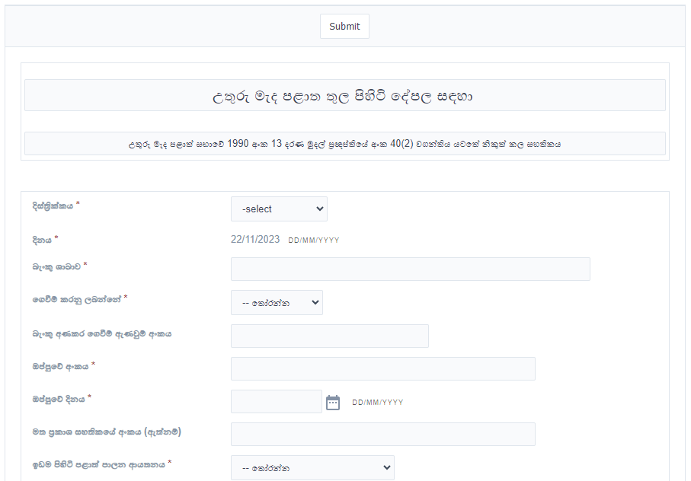
Then

Slide 8
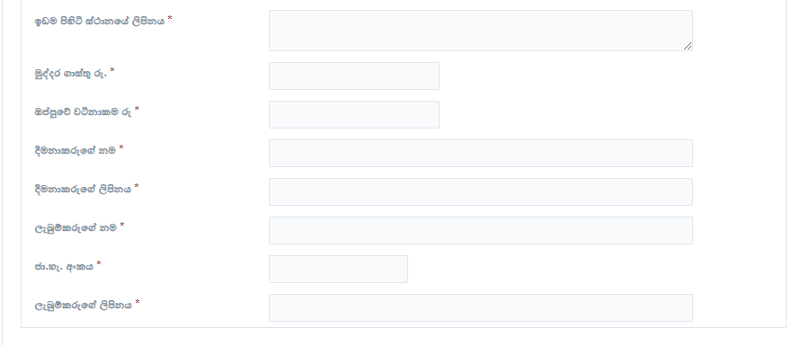

Filling the all blanks..
* Fields are Compulsory.

Slide 9
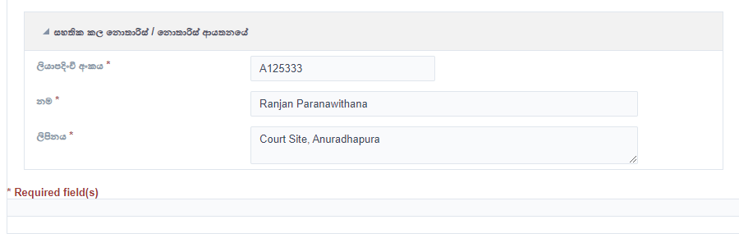
This Section is auto filled..

Slide 10
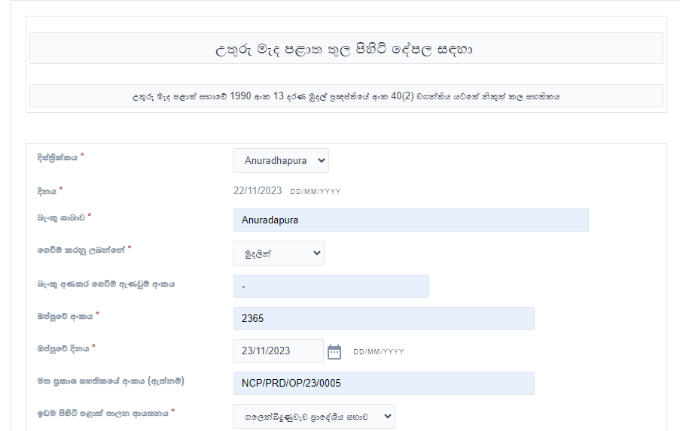

Slide 11
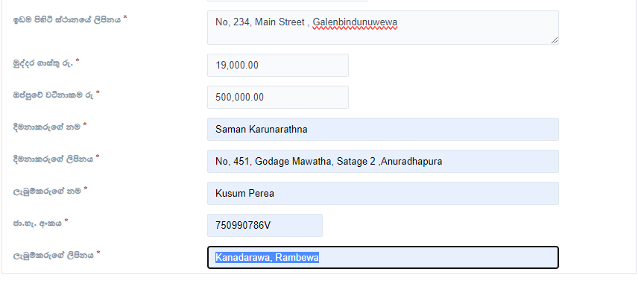

Slide 12
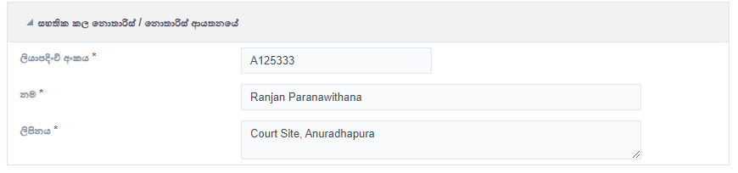

Slide 13

After that use

Slide 14
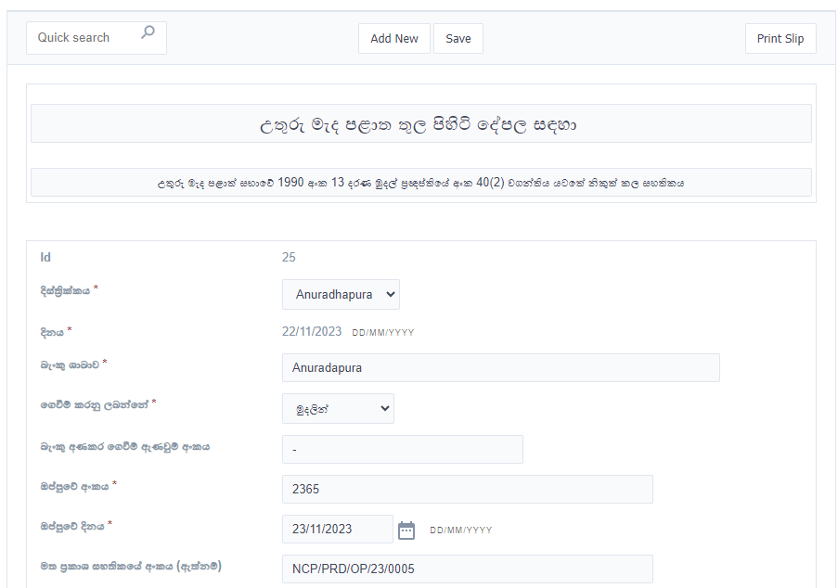
Then check your filled information..

Slide 15
If you are satisfied
Select Print Slip

Slide 16
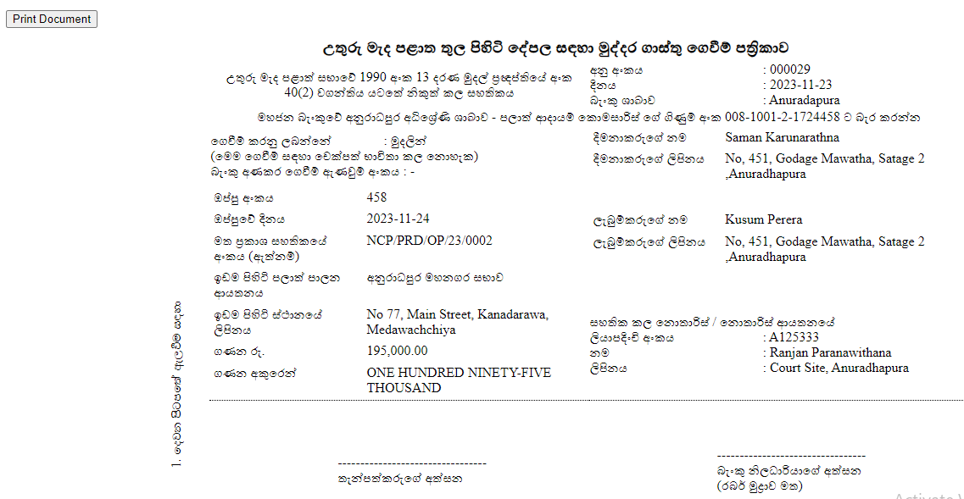
Then select Print Document

Slide 17
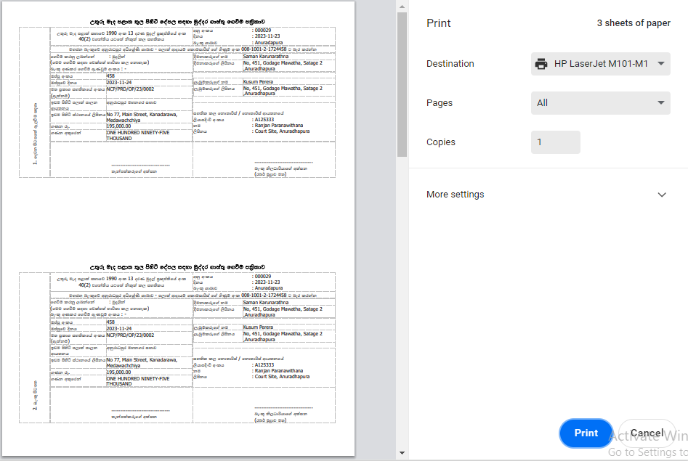
Now select Print

Slide 18
Thank you
If you have any issue – Contact –
JAYANTHA INDIKE
Senior Tax Officer
025-2260985/0779587938

